Slide 1


Javascript
16 September 2016 – Javascript

Slide 2
Agenda
Recap from previous session
What is an algorithm?
What is DHTML?
DHTML Technologies
HTML, CSS, JavaScript
Introduction to JavaScript
What is JavaScript ?
Implementing JavaScript into Web pages
JavaScript Syntax
Document Object Model

Slide 3
Recap from previous session
Chapter one

Slide 4
HTML
What is a Web Page?
HTML Basics
Hyperlinks, Images & Formatting
Headings and paragraphs
The <head> section: Title, Meta, Script, Style
The <body> section
Text styling and formatting tags
Hyperlinks: <a>, Hyperlinks and sections
Images: <img>
Lists: <ol>, <ul> and <dl>
The <div> and the <span> elements
HTML tables
HTML forms
Introduction to HTML

Slide 5
CSS
Selectors and style definitions
Linking HTML and CSS
Fonts, Backgrounds, Borders
The Box Model
Alignment, Z-Index, Margin, Padding
Positioning and Floating Elements
Visibility, Display, Overflow
Introduction to HTML

Slide 6
What is an Algorithm?
Chapter one

Slide 7
What is an Algorithm?
Algorithm
A set of steps from a computer program to accomplish a task
Well-defined computational procedure that takes some value, or set of values, as input and produces some value, or set of values, as output -> An algorithm is thus a sequence of computational steps that transform the input into the output.
What is DHTML ?

Slide 8
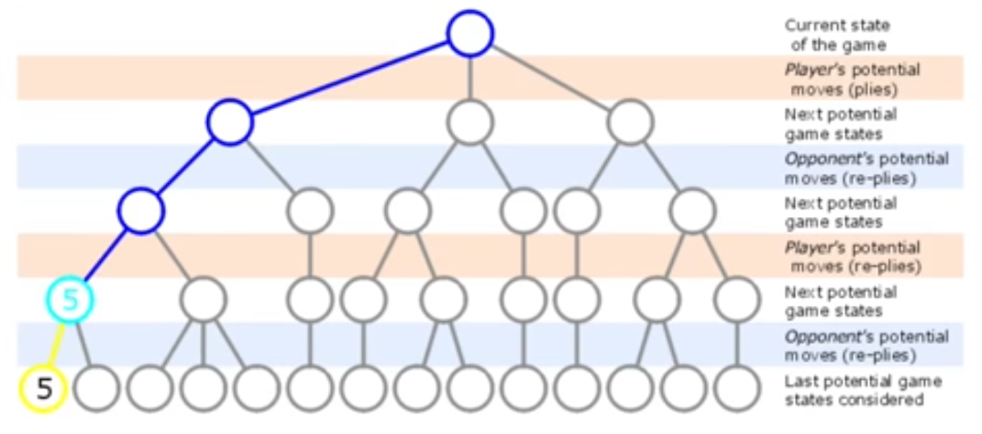
What is an Algorithm?
Algorithm
E.g. Finding Google locations / Maze games, Chess
What is DHTML ?

Slide 9
What is a good algorithm?
Good algorithm
Correctness
Efficiency
What is DHTML ?

Slide 10
Problem solving and implementation
Problem solving
Produce an ordered sequence of steps that describe solution of problem
This sequence of steps is called algorithm
Implementation
Implement the program in some programming language
What is DHTML ?

Slide 11
Steps in problem solving
Pseudo code
An artificial and informal language that helps programmers develop algorithms. It is very similar to everyday English
Example: Write an algorithm to determine the sum of 2 numbers
Pseudo code:
Input 2 numbers
Calculate their Sum
Print Sum
Pseudo code:
Step1: Input N1, N2
Step2: Sum <- N1+N2
Steps3: Print Sum
What is DHTML ?

Slide 12
Steps in problem solving
The Flowchart
A schematic representation of a sequence of operations, as in a manufacturing process or computer program
Shows logic of an algorithm
Emphasizes individual steps and their interconnections
What is DHTML ?

Slide 13
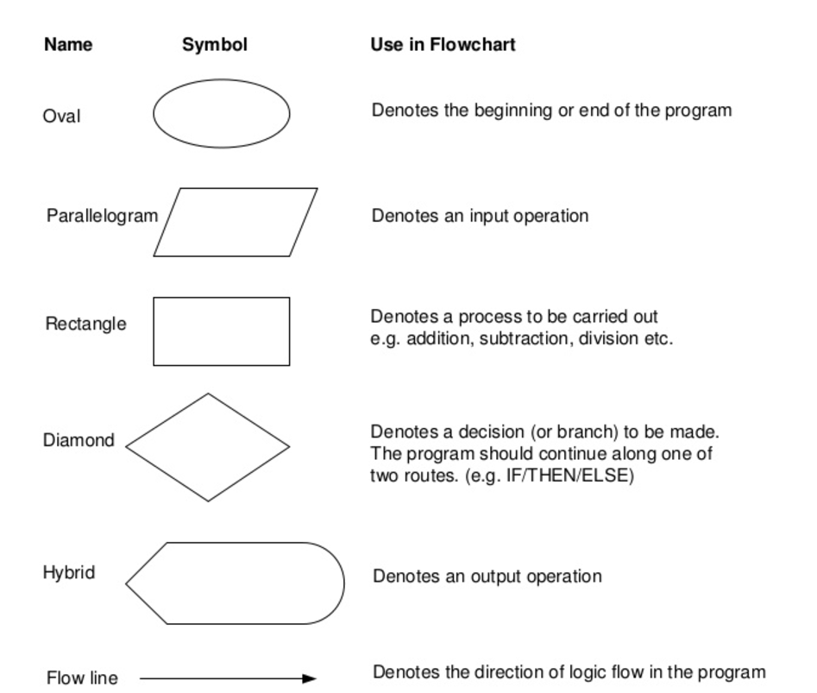
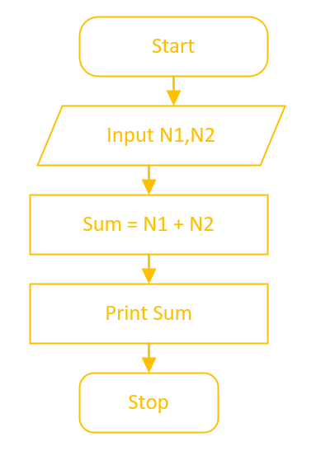
Steps in problem solving
The Flowchart
What is DHTML ?

Slide 14
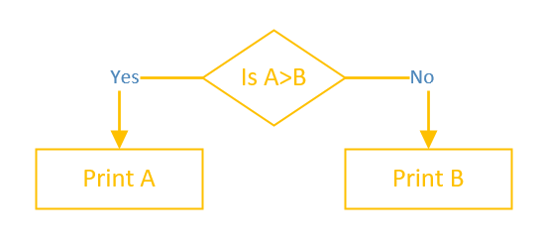
Steps in problem solving
Decision structures
If condition then
True alternative
Else
False alternative
Endif
What is DHTML ?

Slide 15
Steps in problem solving
Exercises:
Average mean of 3 numbers
Maximum from 2 numbers
Calculate student final grade (from 3 grades) and indicate if he is passing or failing the class
Highest number from 3 given numbers
Highest number from a list of numbers
Group exercise: Guess the number
Class: Compute factorial
What is DHTML ?

Slide 16
What is DHTML?
Chapter one

Slide 17
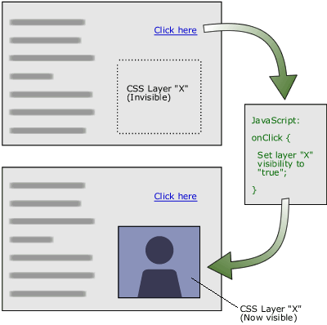
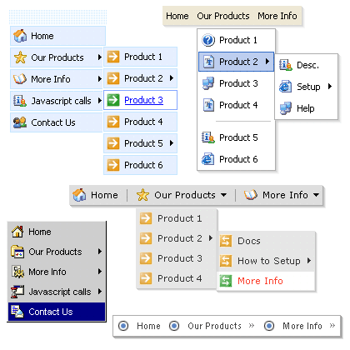
What is DHTML?
DHTML
Dynamic Behavior at the Client Side
What is DHTML ?

Slide 18
What is DHTML
Dynamic HTML (DHTML)
Makes possible a Web page to react and change in response to the user’s actions
DHTML = HTML + CSS + JavaScript
DHTML
HTML
CSS
JavaScript
DOM
What is DHTML ?

Slide 19
DHTML Technologies
XHTML, CSS, Javascript
Chapter two

Slide 20
DHTML = HTML + CSS + JavaScript
HTML defines Web sites content through semantic tags (headings, paragraphs, lists, …)
CSS defines 'rules' or 'styles' for presenting every aspect of an HTML document
Font (family, size, color, weight, etc.)
Background (color, image, position, repeat)
Position and layout (of any object on the page)
JavaScript defines dynamic behavior
Programming logic for interaction with the user, to handle events, etc.
DHTML Technologies

Slide 21
Introduction to JavaScript
Dynamic Behavior in a Web Page
Chapter three

Slide 22
What is JavaScript ?
JavaScript is a front-end scripting language developed by Netscape for dynamic content
Lightweight, but with limited capabilities
Can be used as object-oriented language
Client-side technology
Embedded in your HTML page
Interpreted by the Web browser
Simple and flexible
Powerful to manipulate the DOM
Introduction to JavaScript

Slide 23
JavaScript Advantages
JavaScript allows interactivity such as:
Implementing form validation
React to user actions, e.g. handle keys
Changing an image on moving mouse over it
Sections of a page appearing and disappearing
Content loading and changing dynamically
Performing complex calculations
Custom HTML controls, e.g. scrollable table
Implementing AJAX functionality
Introduction to JavaScript

Slide 24
Using JavaScript Code
The JavaScript code can be placed in:
<script> tag in the head
<script> tag in the body – not recommended
External files, linked via <script> tag the head
Files usually have .js extension
Highly recommended
The .js files get cached by the browser
<script src="scripts.js">
<!– code placed here will not be executed! -->
</script>
Introduction to JavaScript

Slide 25
JavaScript - When is Executed ?
JavaScript code is executed during the page loading or when the browser fires an event
All statements are executed at page loading
Some statements just define functions that can be called later
Function calls or code can be attached as "event handlers" via tag attributes
Executed when the event is fired by the browser
<img src="logo.gif" onclick="alert('clicked!')" />
Introduction to JavaScript

Slide 26
Standard Popup Boxes
Alert box with text and [OK] button
Just a message shown in a dialog box:
Confirmation box
Contains text, [OK] button and [Cancel] button:
Prompt box
Contains text, input field with default value:
alert("Some text here");
confirm("Are you sure?");
prompt("Enter amount", 10);
JavaScript Syntax

Slide 27
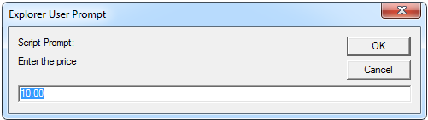
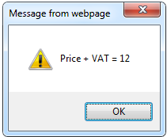
JavaScript Prompt - Example
price = prompt("Enter the price", "10.00");
alert('Price + VAT = ' + price * 1.24);
Chapter three

Slide 28
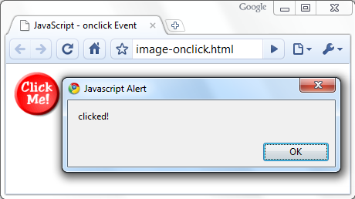
Calling a JavaScript Function from Event Handler - Example
<html>
<head>
<script>
function test(message) {
alert(message);
}
</script>
</head>
<body>
<img src="logo.gif" onclick="test('clicked!')" />
</body>
</html>
Introduction to JavaScript

Slide 29
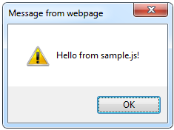
Using External Script Files
Using external script files:
External JavaScript file:
<img <html>
<head>
<script src="sample.js">
</script>
</head>
<body>
<button onclick="sample()" value="Call JavaScript
function from sample.js" />
</body>
</html>
The <script> tag is always empty
function sample() {
alert('Hello from sample.js!')
}
Introduction to JavaScript

Slide 30
JavaScript Syntax
Chapter four

Slide 31
JavaScript Syntax
JavaScript statements (instructions to be executed):
Values
Fixed values (literals) (e.g.
Variable values (variables) (e.g.var x); 10.5, “Mary Johansen”)
Operators (+ - * /)
Expressions (values, variables, and operators. E.g. 1*2)
Keywords ( identify actions to be performed. E.g. Break, continue, do …while, for, function, if … else, return, switch, try…catch, var)
Comments (e.g. var x = 1; // I will be executed )
Functions (can return values)
JavaScript Syntax

Slide 32
JavaScript Variables
JavaScript variables are containers for storing data values.
All JavaScript variables must be identified with unique names.
Assignment operator ( “=“)
var price1 = 2;
var price2 = 3;
var total = price1+price2;
var summary = “Ana are mere”;
var confirmation_message = “Da! Am!”
JavaScript Syntax

Slide 33
JavaScript Operators
Assignment operators assign values to JavaScript variables.
Operator | Example | Same As
= | x = y | x = y
+= | x += y | x = x + y
-= | x -= y | x = x - y
*= | x *= y | x = x * y
/= | x /= y | x = x / y
%= | x %= y | x = x % y
JavaScript Syntax

Slide 34
JavaScript Operator Presedence Value
Assignment operators assign values to JavaScript variables.
Operator | Description | Example
( ) | Expression grouping | (3 + 4)
. | Member | person.name
[] | Member | person["name"]
() | Function call | myFunction()
new | Create | new Date()
++ | Postfix Increment | i++
-- | Postfix Decrement | i--
! | Logical not | !(x==y)
typeof | Type | typeof x
** | Exponentiation | 10 ** 2
< | Less than | x < y
<= | Less than or equal | x <= y
> | Greater than | x > y
>= | Greater than or equal | x >= y
== | Equal | x == y
=== | Strict equal | x === y
!= | Unequal | x != y
!== | Strict unequal | x !== y
JavaScript Syntax

Slide 35
Data Types
JavaScript data types:
Numbers (integer, floating-point)
Boolean (true / false)
String type – string of characters
Arrays and associative arrays (hash tables)
Undefined and null types
var statement = true;
var myName = "You can use both single or double quotes for strings";
var my_array = [1, 5.3, "aaa"]; var my_hash = {a:2, b:3, c:"text"};
var someData; // undefined
someData = null;
Chapter three

Slide 36
Everything is Object
Every variable can be considered as object
For example strings and arrays have member functions:
var test = "some string";
alert(test[7]); // shows letter 'r'
alert(test.charAt(5)); // shows letter 's'
alert("test".charAt(1)); //shows letter 'e'
alert("test".substring(1, 3)); //shows 'es'
var arr = [1, 3, 4];
alert(arr.length); // shows 3
arr.push(7); // appends 7 to end of array
alert(arr[3]); // shows 4th element which is 7
JavaScript Syntax

Slide 37
String Operations
The + operator joins strings
What is "9" + 9?
Converting string to number:
string1 = "fat ";
string2 = "cats";
alert(string1 + string2); // fat cats
alert("9" + 9); // 99, + acts as concatenation
alert(parseInt("9") + 9); // 18, + acts as addition
JavaScript Syntax

Slide 38
Arrays Operations and Properties
Declaring new empty array:
Declaring an array holding few elements:
Appending an element / getting the last element:
Reading the number of elements (array length):
Finding element's index in the array:
var arr = new Array();
var arr = [1, 2, 3, 4, 5];
arr.push(3);
var element = arr.pop();
arr.length;
arr.indexOf(1);
JavaScript Syntax

Slide 39
Conditional Statement (if)
Syntax
if (condition) {
block of code to be executed if the condition is true
} else {
block of code to be executed if the condition is false
}
Example:
>
Greater than
<
Less than
>=
Greater than or equal to
<=
Less than or equal to
==
Equal
!=
Not equal
unitPrice = 1.30;
if (quantity > 100) {
unitPrice = 1.20;}
else {
unitPrice = 1.40;
}
JavaScript Syntax

Slide 40
Switch Statement
The switch statement works like in C#:
switch (variable) {
case 1:
// do something
break;
case 'a':
// do something else
break;
case 3.14:
// another code
break;
default:
// something completely different
}
JavaScript Syntax

Slide 41
Loops
Like in C#
for loop
while loop
do … while loop
var counter;
for (counter=0; counter<4; counter++) {
alert(counter);
}
while (counter < 5) {
alert(++counter);
}
JavaScript Syntax

Slide 42
Functions
A JavaScript function
a block of code designed to perform a particular task.
Declaration
Invocation
Example
function name(parameter1, parameter2, parameter3) { code to be executed }
var my_variable = name(argument1, argument2,argument3);
function sum(a1, a2) { return a1 + a2; // The function returns the sum of a1 and a2 }
Var result = sum(1,2); //will return 3
JavaScript Syntax

Slide 43
Functions
Code structure – splitting code into parts
Data comes in, processed, result returned
function average(a, b, c)
{
var total;
total = a + b + c;
return total / 3;
}
Parameters come in here
Declaring variables is optional. Type is never declared
Value returned here
JavaScript Syntax

Slide 44
Sum of Numbers - Example
<html>
<head>
<title>JavaScript Demo</title>
<script type="text/javascript">
function calcSum() {
value1 = parseInt(document.mainForm.textBox1.value);
value2 = parseInt(document.mainForm.textBox2.value);
sum = value1 + value2;
document.mainForm.textBoxSum.value = sum;
}
</script>
</head>
JavaScript Syntax

Slide 45
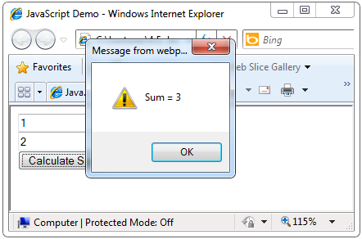
Sum of Numbers - Example (2)
<body>
<form name="mainForm">
<input type="text" name="textBox1" /> <br/>
<input type="text" name="textBox2" /> <br/>
<input type="button" value="Process"
onclick="javascript: calcSum()" />
<input type="text" name="textBoxSum"
readonly="readonly"/>
</form>
</body>
</html>
JavaScript Syntax

Slide 46
Document Object Model
(DOM)
Chapter five

Slide 47
window
history
document
location
link name
form name
anchor name
textbox name
button name
radio name
value
value
value
textarea name
submit name
checkbox name
password name
reset name
select name
Document Object Model

Slide 48
Document Object Model
Every HTML element is accessible via the JavaScript DOM API
Most DOM objects can be manipulated by the programmer
The event model lets a document to react when the user does something on the page
Advantages
Create interactive pages
Updates the objects of a page without reloading it
Document Object Model

Slide 49
Accessing Elements
Access elements via their ID attribute
Via the class name attribute
Via tag name
Returns array of descendant <img> elements of the element "el"
Instead of document, any element can be used starting access point
var elem = document.getElementById("some_id")
var cls = document.getElementsByClassName("some_name")
var images = document.getElementsByTagName("img")
Document Object Model

Slide 50
DOM Manipulation
Once we access an element, we can read and write its attributes
function change(state) {
var lampImg = document.getElementById("lamp");
lampImg.src = "lamp_" + state + ".png";
var statusDiv = document.getElementById("statusDiv");
statusDiv.innerHTML = "The lamp is " + state";
}
…
<img src="test_on.gif" onmouseover="change('off')"
onmouseout="change('on')" />
Document Object Model

Slide 51
Common Element Properties
Most of the properties are derived from the HTML attributes of the tag
E.g. id, name, value, href, alt, title, src, etc…
style property – allows modifying the CSS styles of the element
Corresponds to the inline style of the element
Not the properties derived from embedded or external CSS rules
Example: style.width, style.marginTop, style.backgroundImage
Document Object Model

Slide 52
Accessing Elements through the DOM Tree - Example
var el = document.getElementById('div_tag');
alert(el.childNodes[0].value);
alert(el.childNodes[1].getElementsByTagName('span').id);
…
<div id="div_tag">
<input type="text" value="test text" />
<div>
<span id="test">test span</span>
</div>
</div>
Warning: may not return what you expected due to Browser differences
Document Object Model

Slide 53
Take Aways
Chapter seven

Slide 54
Take Aways
What is an algorithm?
How can an algorithm be represented?
What is DHTML?
DHTML Technologies: HTML, CSS, JavaScript
What is JavaScript?
What datatypes can we use?
Javascript operators
Conditional statements
Loops
Functions
Document Object Model
HTML Frames

